Slide 1
Port Vila, July 2017
The Government
of The Republic
of Vanuatu
Vanuatu ICT Developments
“Jethro Webston Tambeana, OGCIO Office”
Presented to PacNOG 20 Workshop, Tanoa Hotel,Suva

Slide 2
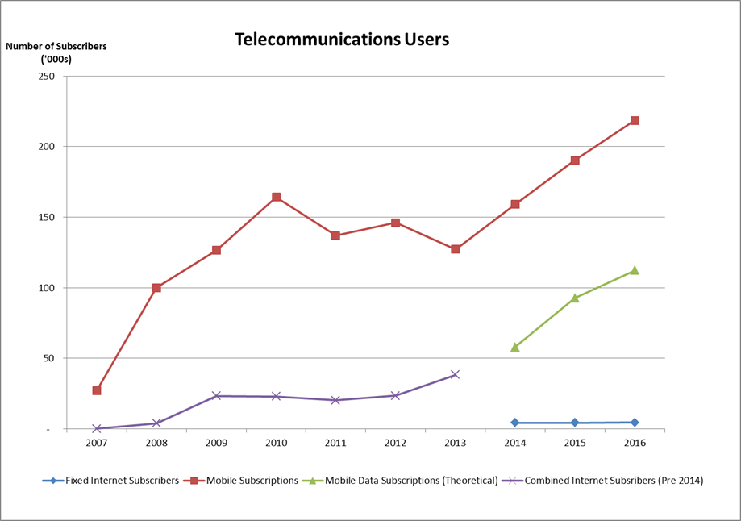

Slide 3
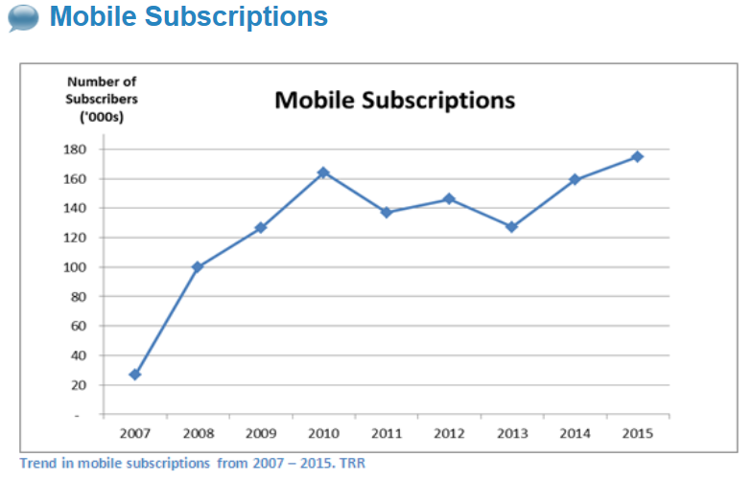

Slide 4
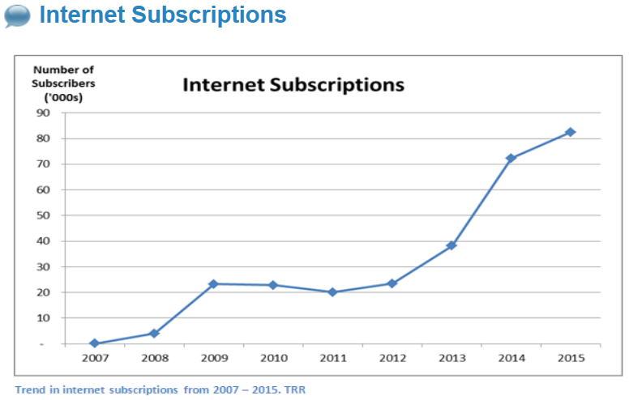

Slide 5
Internet Access
2.5G, 3G, 4G services
DSL
Wifi hotspots
Wireless broadband (ubnt, WiMAX, etc.)
Fiber

Slide 6
ISPs & Mobile Operators
TVL – Mobile & Internet (nationwide)
Digicel – Mobile & Internet (nationwide)
Telsat – Internet (Urban centers)
SPIM – Internet (Port Vila)
Wantok – Internet & Voice (Port Vila)
Egov Network – Government Network (urban centers & Provincial HQs)

Slide 7
VU IXP
All ISPs connected
D-root & i-root server installed
Google & Akamai cache servers installed
IP Transit issue – discussions currently underway to resolve issue

Slide 8
Submarine Cable
Second cable discussions still ongoing – either via Noumea or via Solomon Is to PNG
Work in progress to connect USP Emalus campus to submarine cable in Port Vila

Slide 9
Sale of TVL to ATH
Mauritius Telecom recently sold its shares at Telecom Vanuatu Ltd to ATH

Slide 10
Digital TV
Deployment of Digital TV in Port Vila & Santo
Plan to expand coverage to other provincial centers

Slide 11
eGov Network Developments
Upgrade Radio network from NEC to Cambium
Upgrade Video Conferencing system from Huawei to Trueconf
Upgrade MPLS infrastructure from Huawei to Cisco
Planned upgrade of VoIP system from Huawei to Xorcom (Asterisk based)
Plan to connect remote Health facilities (clinics, medical centers) to eGov network (Telemedicine)

Slide 12
Tankio Tumas

