Slide 1

FSM Telecommunincations Corporation
Nov-30th - 2015
Country Report
for PacNOG Guam

Slide 2
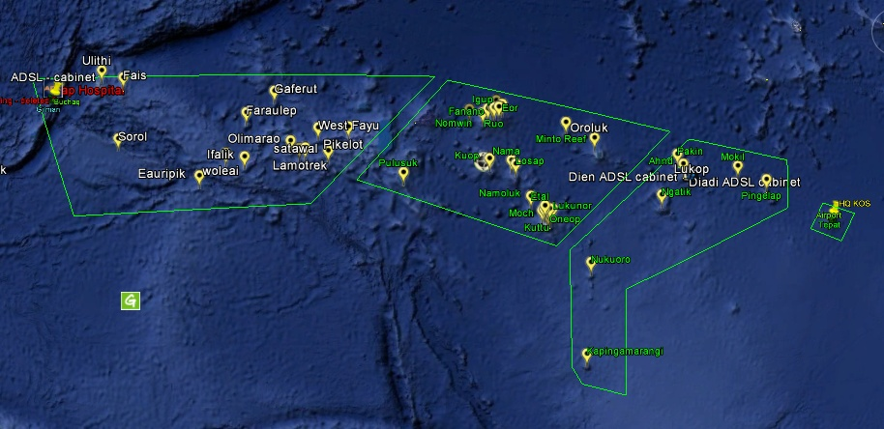
Federated States of Micronesia (FSM)
Island Groups

Slide 3
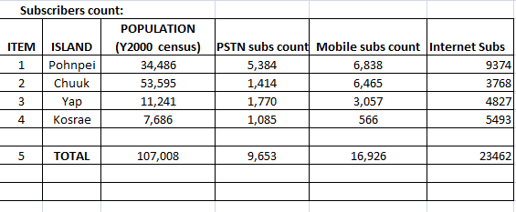

FSMTC Population and Users count

Slide 4
Previous services
1. Internet :
a. - Dialups
b. - WiFi
2. PSTN
3. GSM Cellular (2G)
Facsimile (FAX)

Slide 5
Developments or Service Enhances
- Marine Fiber connecitivty to the world (Pohnpei State Only)
- faster internet speed
- WiFi Hotspots,
- ADSL internet services over land and lagoon islands
- 3G cellular services

Slide 6
CONSTRAINTS for deploying services
Obstructional terrains (Mountains / trees etc.) difficulty for copper cable run and wireless LoS connectivity to the homes
- Satellite bandwidth limitation
- Lack of Marine optic cable linking other three main islands to the world.
COSTING

Slide 7
FUTURE PLANS
- Improve means of bringing voice and data services to remote locations on land & on atolls.
- Implement and deploy marine cable connectivity to each main island.
- deploy fiber connectivity to the homes Gov’t and private businesses
- deploy more satellite links to bring voice and data services to the outer islands.
- Streaming TV Video services to the homes

Slide 8

FSMTC Participants:
Alfred Aliven – Technical Superintendent Engineer, Pohnpei
Engko Danis – Assistant System Administrator, Pohnpei
Chris Chingyan – Internet Systems Support Specialist, Yap
Jacob John – Internet Systems Support Specialist, Kosrae
Mark Mori – Field Technician, Chuuk
Jayjay Fritz – Internet Systems Support Specialist, Chuuk

Slide 9

FSMTC Site presentation on Google Earth
- End -

